Slide 1

What can Machine Learning do for you?

Slide 2
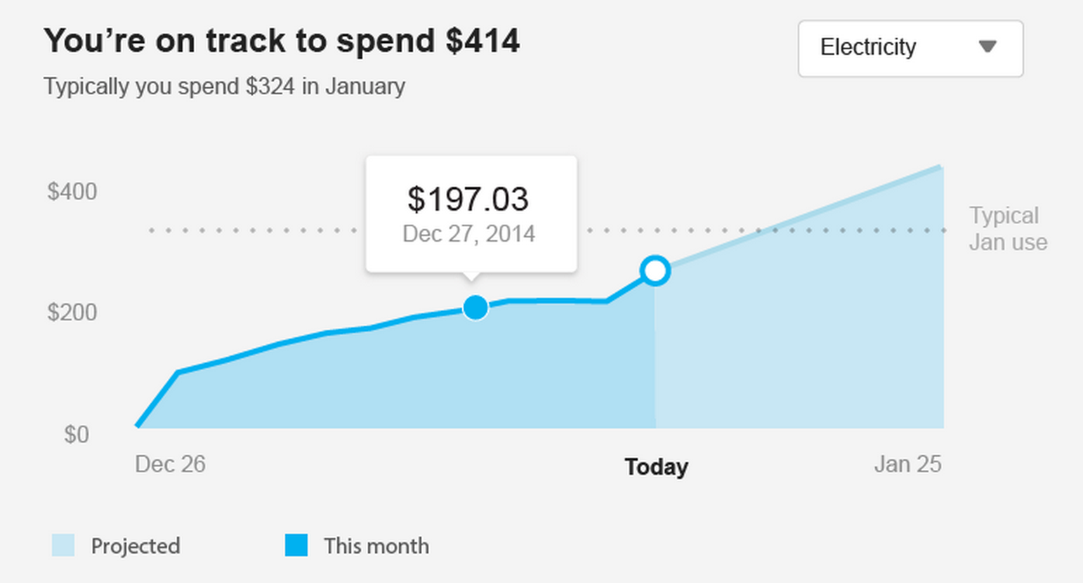
What is Machine Learning
Estimate an unknown value
Predict future usage
algorithms that solve a problem by learning from data

Slide 3
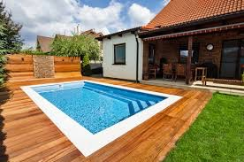

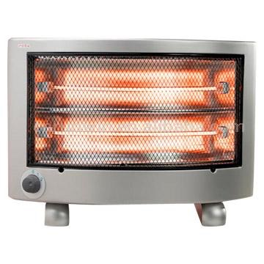
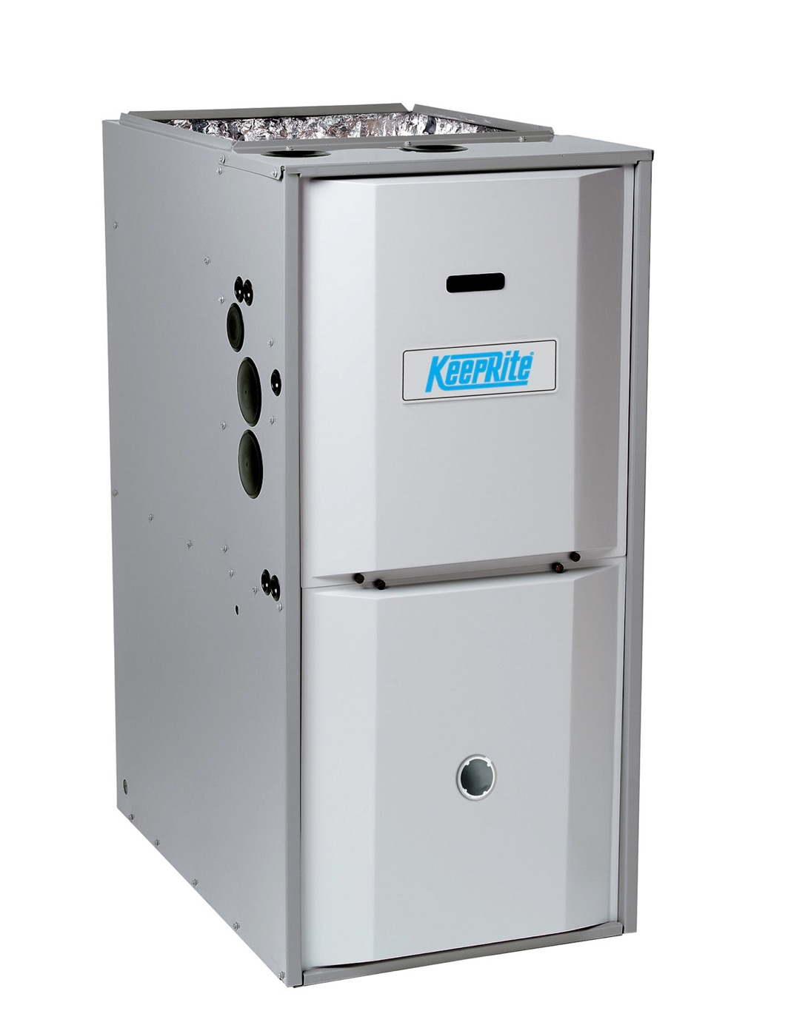
What is Machine Learning
Estimate an unknown value
Predict future usage
Estimate something about a home
algorithms that solve a problem by learning from data
sqft

Slide 4
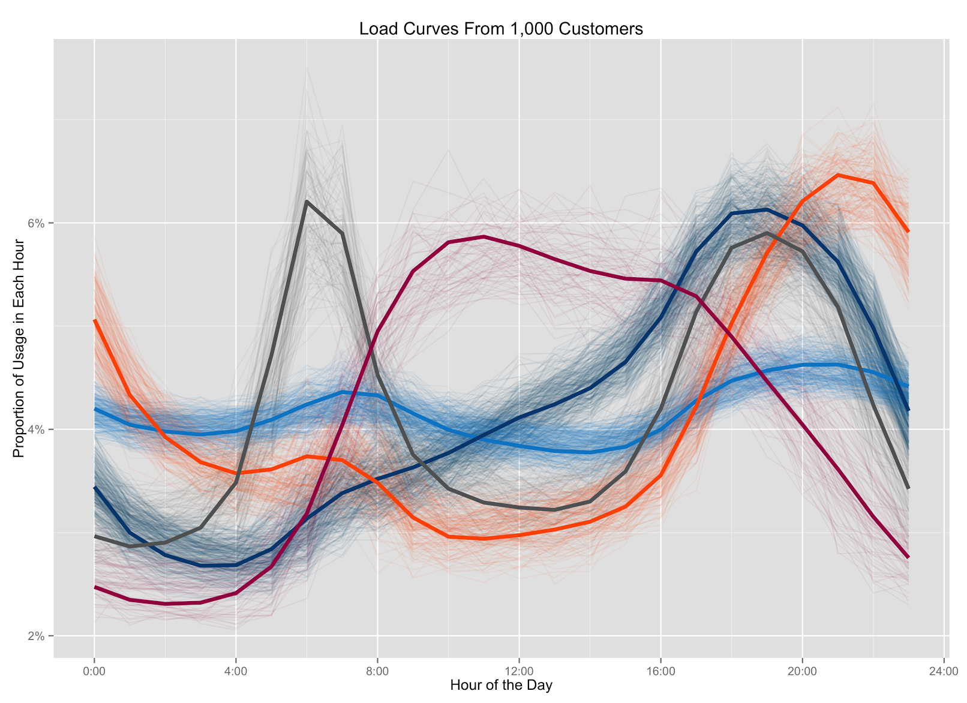
What is Machine Learning
Estimate an unknown value
Predict future usage
Estimate something about a home
Find patterns in data
algorithms that solve a problem by learning from data
Notes:
What are some examples of those problems?

Slide 5
Standard machine learning setting
Want to estimate some value:
Does this household use GAS or ELECTRIC heat?
Notes:
We want to know this for tip targeting, neighbor compare, disagg

Slide 6
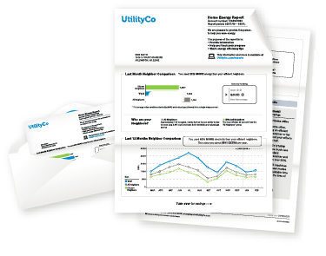
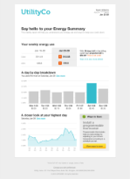
Standard machine learning setting
Want to estimate some value:
Does this household use GAS or ELECTRIC heat?
Have something we know about each household that might help us estimate the unknown value
Jan
Feb
Mar
Apr
May
Jun
Jul
Aug
Sep
Oct
Nov
Dec

Slide 7
Estimating heat type
What do we know about a household that might help us estimate whether it has gas or electric heat?

Slide 8
Estimating heat type

Slide 9
Estimating heat type

Slide 10

Estimating heat type

Slide 11
Estimating heat type
“Features” that help us estimate heat type:
Difference between winter gas usage and shoulder gas usage
Ratio between winter gas usage and shoulder gas usage
Difference between winter elec usage and shoulder elec usage
Ratio between winter elec usage and shoulder elec usage

Slide 12
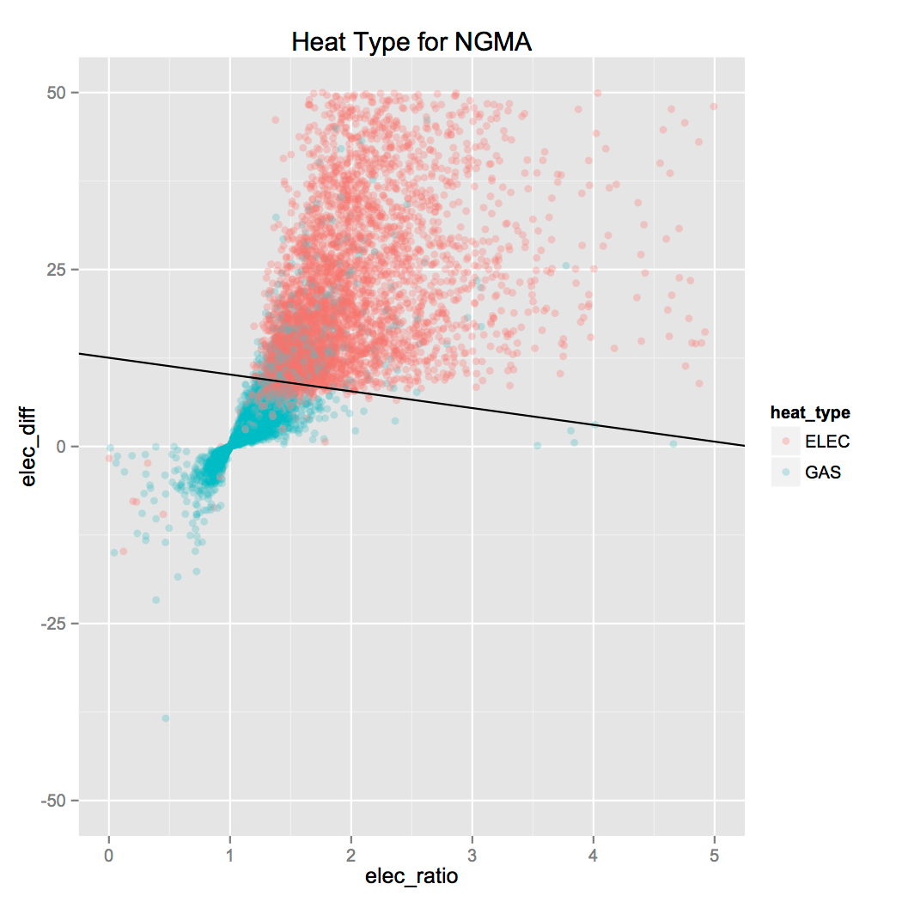
Estimating heat type

Slide 13
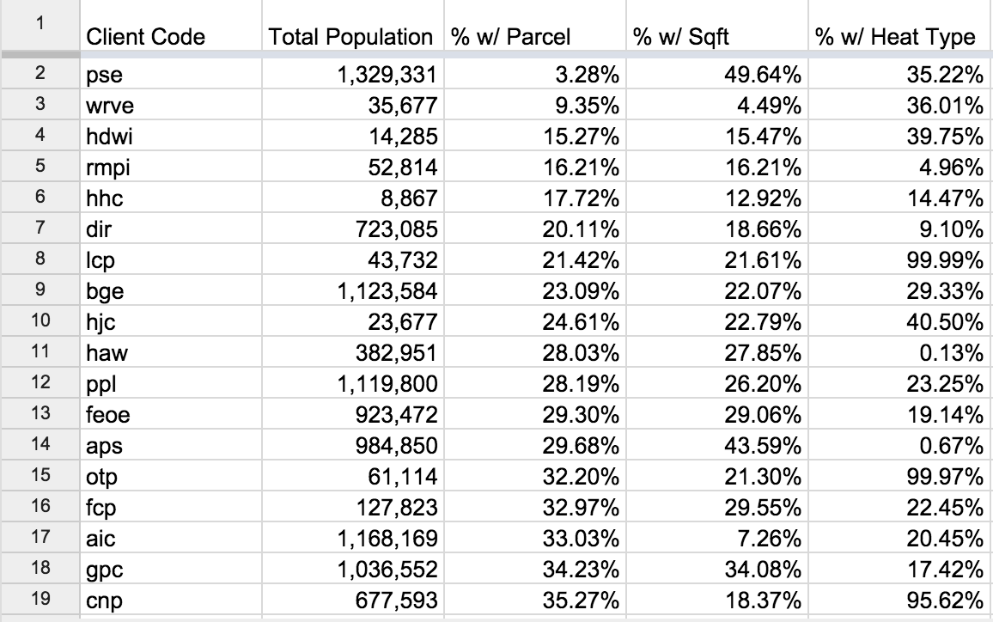
Standard machine learning setting
Want to estimate some value:
Does this household use GAS or ELECTRIC heat?
Have something we know about each household that might help us estimate
Know the answer for some instances
Notes:
Stepping back again to the high level machine learning setting, we have a third element: labeled data

Slide 14
Standard machine learning setting
Want to estimate some value: target variable
Have something we know about each household that might help us estimate: features
Know the answer for some instances: labeled training set
Notes:
Again, just stepping back and defining some terms

Slide 15
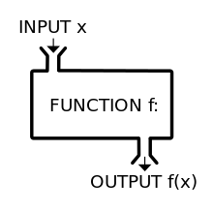
Goal: learn a function

Slide 16
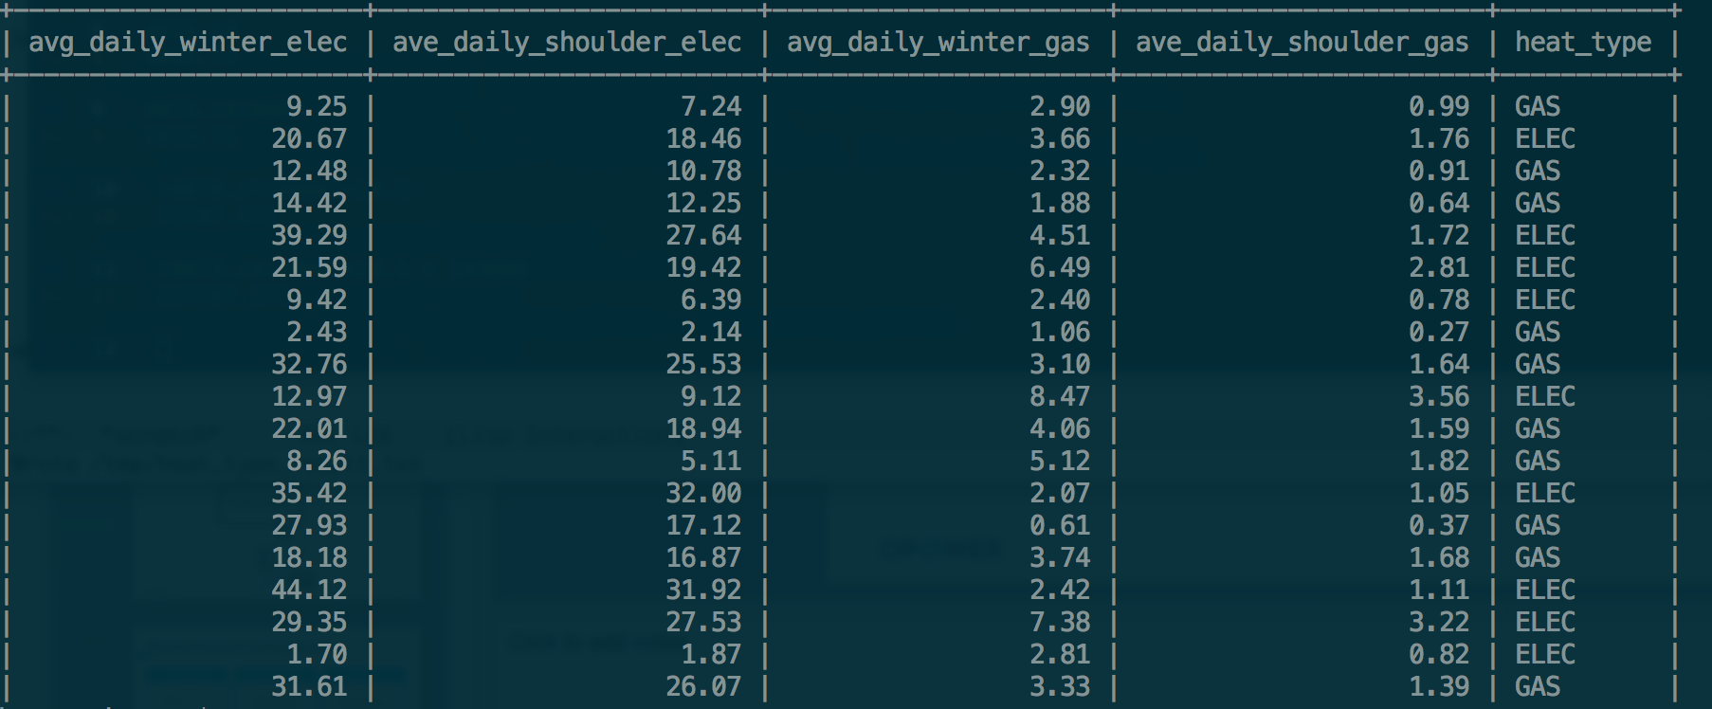
Standard machine learning pipeline
Training Set
Evaluation Set
Real Life
train the function
evaluate how well the function predicts
use the function on new data to get our answers
Model accuracy: 86%
Baseline accuracy: 72%
coeff1: 1.38
coeff2: 0.25
coeff3: 3.59
coeff4: 2.84
Notes:
If you’ve done things properly, your real life accuracy should be similar to your evaluation accuracy

Slide 17
Standard machine learning setting
Want to estimate some value: target variable
Can be category (ELEC/GAS) or number (e.g., kWh)
Category – classification; number – regression
Have something we know about each instance that might help us estimate: features
Know the answer for some instances: labeled training set
The function you use doesn’t really matter
The function we used earlier was logistic regression
Others include SVM, nearest neighbor, neural networks
Notes:
Again, stepping back, I’ll restate this on a more general level
Target variable can be either a category (classification) or a number (regression)
When I say it doesn’t matter, I mean it’s secondary to these other things: do you have good features and lots of training data

Slide 18
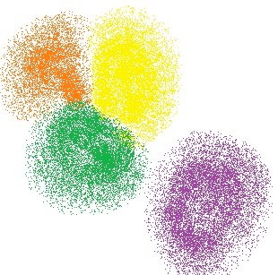
Unsupervised learning
Everything we just saw was called “supervised learning”
What if we don’t have labeled data?
Unsupervised Learning

Slide 19
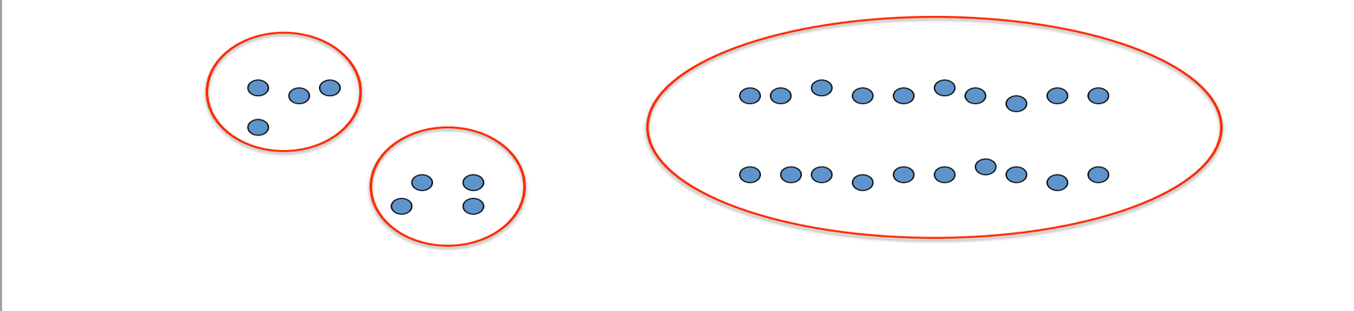
Unsupervised learning
Unsupervised learning is looking for patterns in the data
Don’t know the right answer, and there is no “right answer”
E.g., clustering – how many clusters are there?

Slide 20
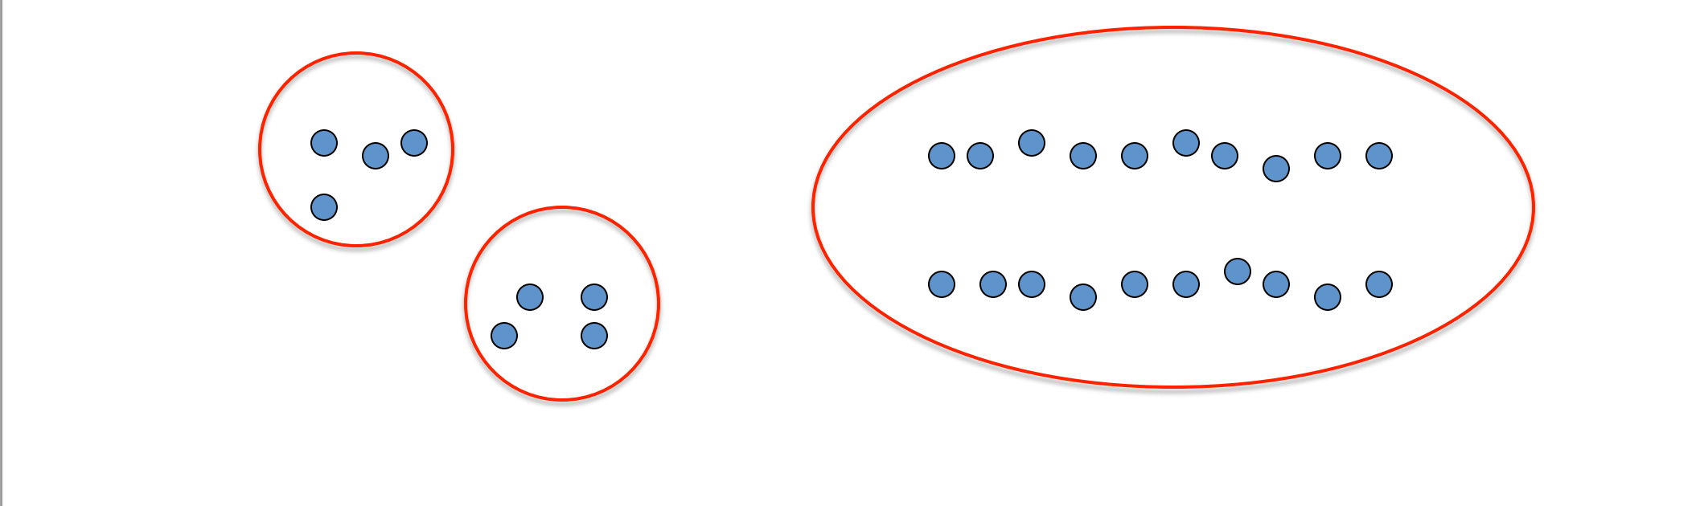
Unsupervised learning
Unsupervised learning is looking for patterns in the data
Don’t know the right answer, and there is no “right answer”
E.g., clustering – how many clusters are there?

Slide 21
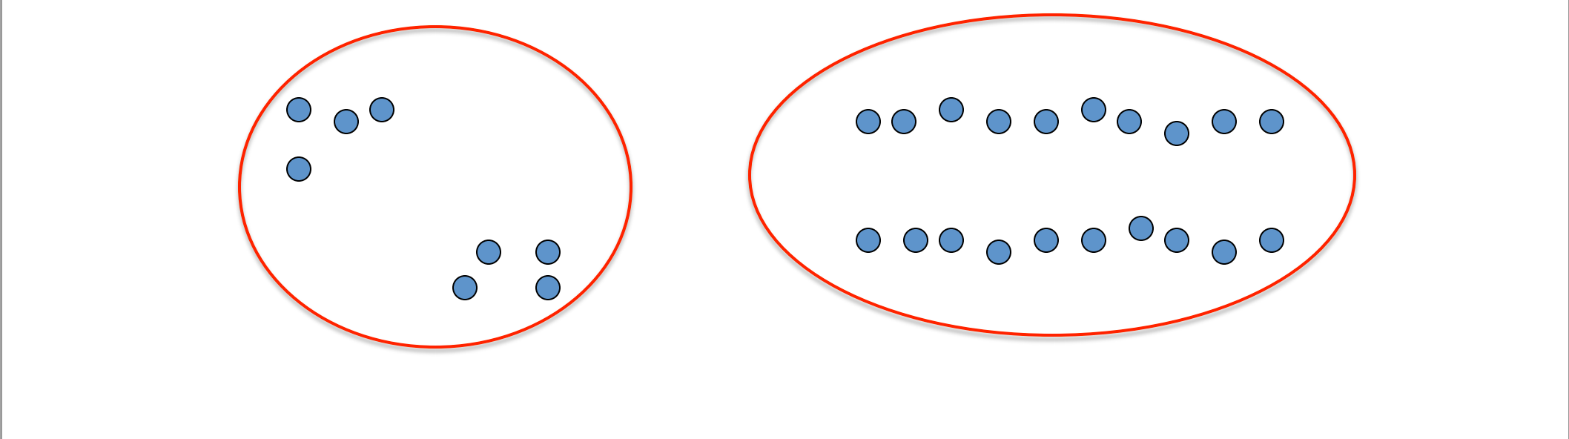
Unsupervised learning
Unsupervised learning is looking for patterns in the data
Don’t know the right answer, and there is no “right answer”
E.g., clustering – how many clusters are there?

Slide 22
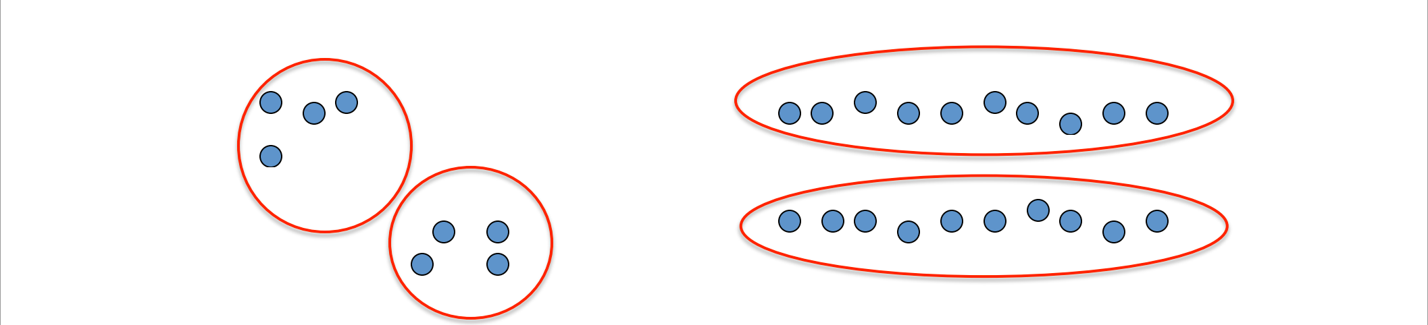
Unsupervised learning
Unsupervised learning is looking for patterns in the data
Don’t know the right answer, and there is no “right answer”
E.g., clustering – how many clusters are there?

Slide 23



Data Science workflow
Research
Data exploration
Accuracy testing
Prototyping
Initial Rollout
Professional Service
Pilot
General Availability
Productionalized as a service
Available to all clients
Research
Continued exploration
Accuracy testing

Slide 24

Personalization Through Load Curve Analysis

Slide 25
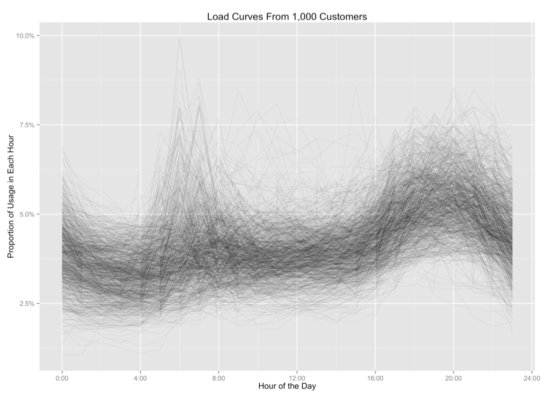
Load Curves – All Customers

Slide 26
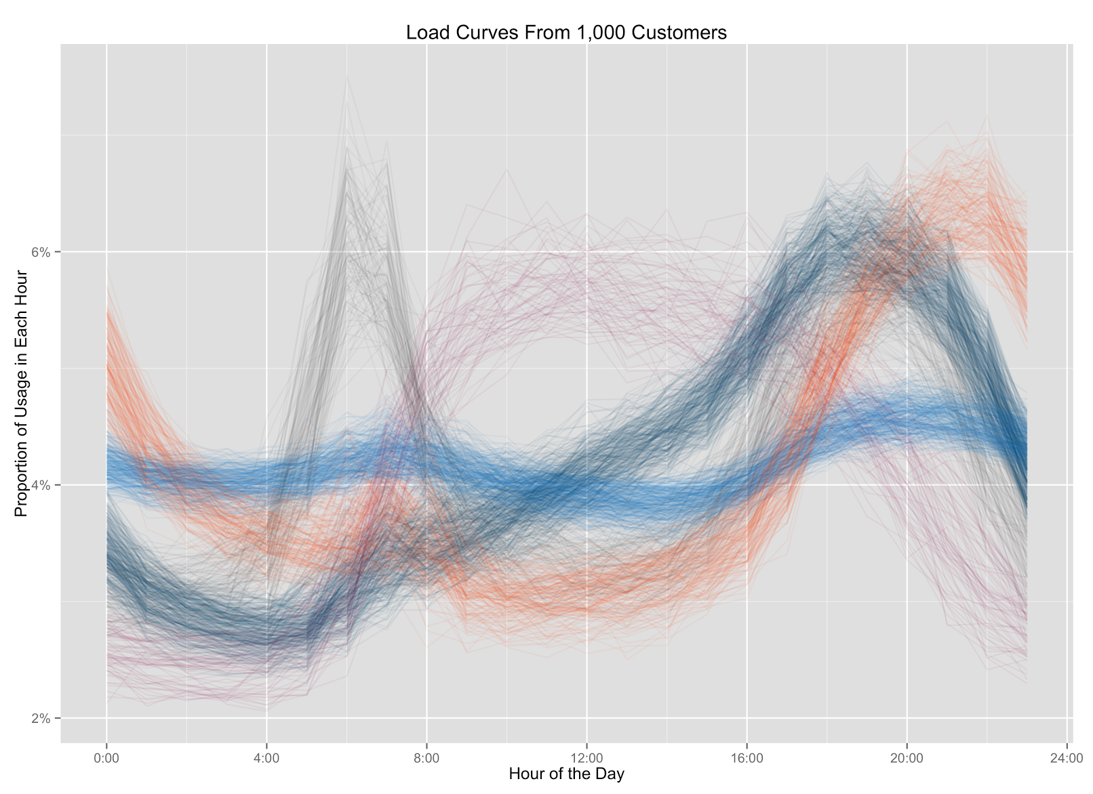
Load Curves – All Customers

Slide 27
Load Curves – All Customers

Slide 28
Load Curve Archetypes
Steady Eddies
Evening Peakers
Night Owls
6%
6%
6%
5%
5%
5%
Proportion of usage in each hour
Proportion of usage in each hour
Proportion of usage in each hour
4%
4%
4%
3%
3%
3%
0.00
4.00
8.00
12.00
16.00
20.00
24.00
0.00
4.00
8.00
12.00
16.00
20.00
24.00
0.00
4.00
8.00
12.00
16.00
20.00
24.00
Hour of the day
Hour of the day
Hour of the day
Twin Peaks
Daytimers
6%
6%
5%
5%
Proportion of usage in each hour
Proportion of usage in each hour
4%
4%
3%
3%
0.00
4.00
8.00
12.00
16.00
20.00
24.00
0.00
4.00
8.00
12.00
16.00
20.00
24.00
Hour of the day
Hour of the day

Slide 29
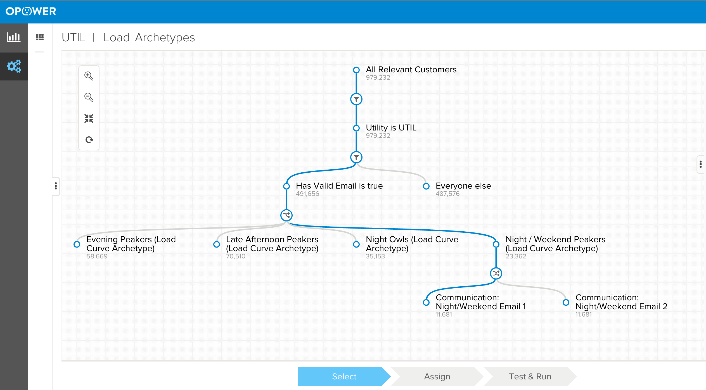
Segmentation

Slide 30
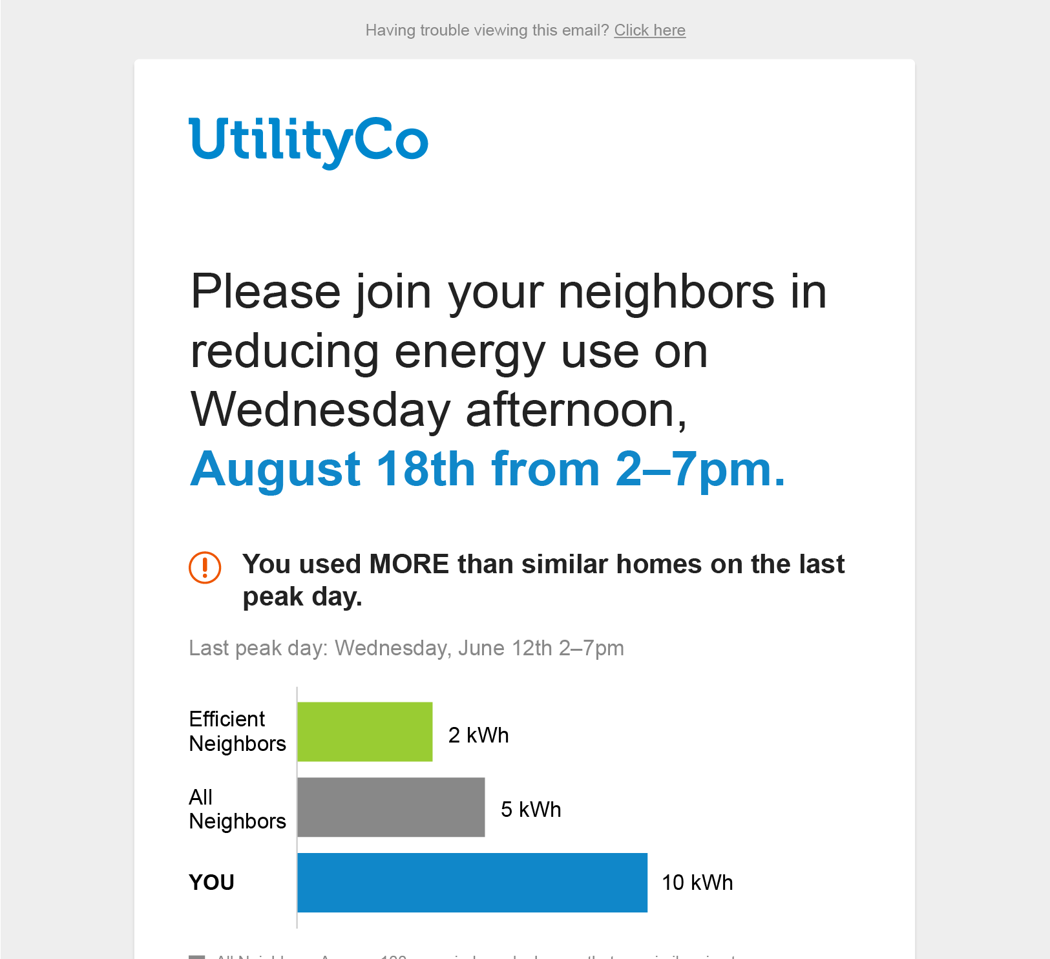

Targeted Messaging: Afternoon Peakers
This is an alert from UtilCo: Tomorrow, Wednesday, July 10th is a peak day. From 2 PM to 7 PM join UtilCo customers by reducing your electric use. Simple ways to save on peak days include postponing dishwashing and other large appliance use until the peak day is over. Thank you for helping us save! To opt out of phone alerts, press 9.

Slide 31
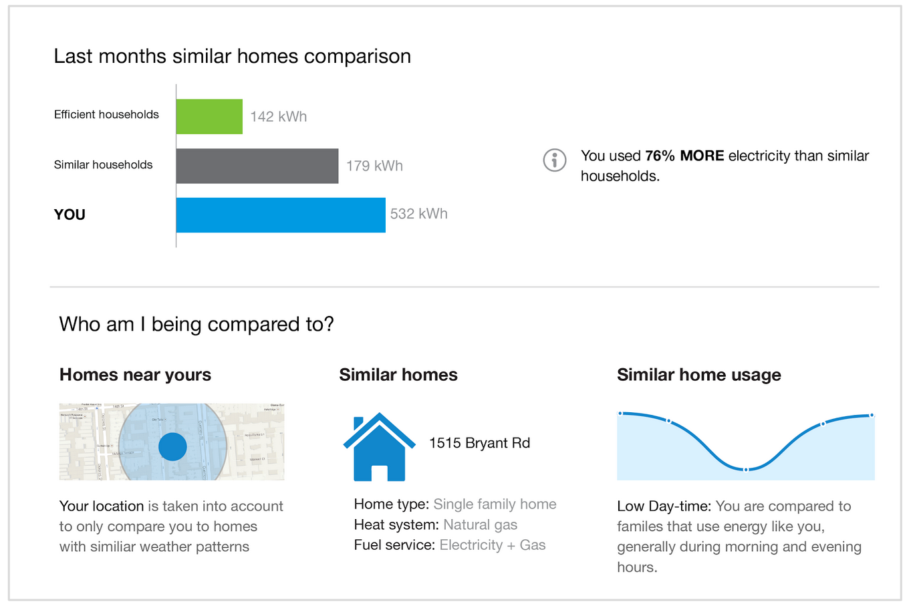
Improved Personalization
Help drive acceptance of neighbor comparison
vision

Slide 32
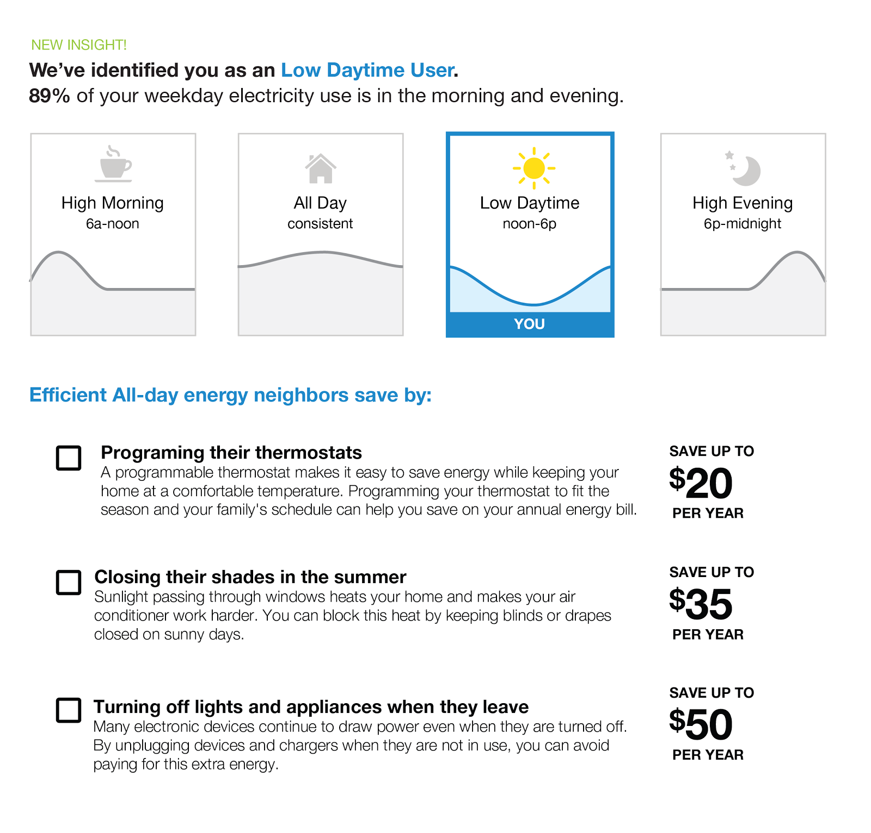
Improved Personalization
Recommendations tailored to profile type
vision

Slide 33
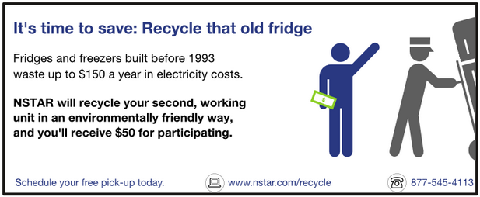

Program Propensity

Slide 34
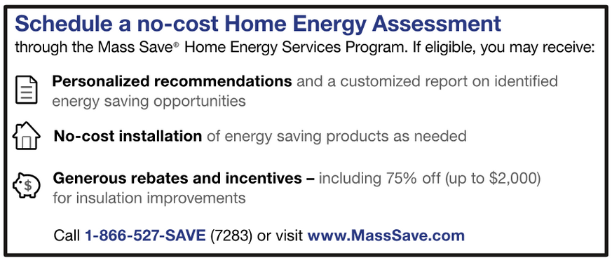
Target the right people with utility programs
Low Propensity Program
Target likely participants
Some customers are more likely to participate in any program
Target specific customers for certain programs
Different types of customers are better fitted for different utility programs, indicated by their propensity
Target low propensity customers for simple programs, and high propensity customers for more involved customers
High Propensity Program
Notes:
----- Meeting Notes (9/1/11 17:46) -----
White paper for why smart meters are good:
ID folks with AC, go crazy on those that aren't setting them

Slide 35
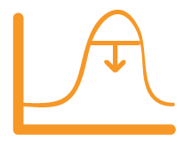




Underneath the hood
Load shape
Monthly usage
Lift participation ~20%
Decrease marketing spend through increasing relevance
Web behavior
Predictive model
$
Income
Home data
Notes:
----- Meeting Notes (9/1/11 17:46) -----
White paper for why smart meters are good:
ID folks with AC, go crazy on those that aren't setting them

Slide 36
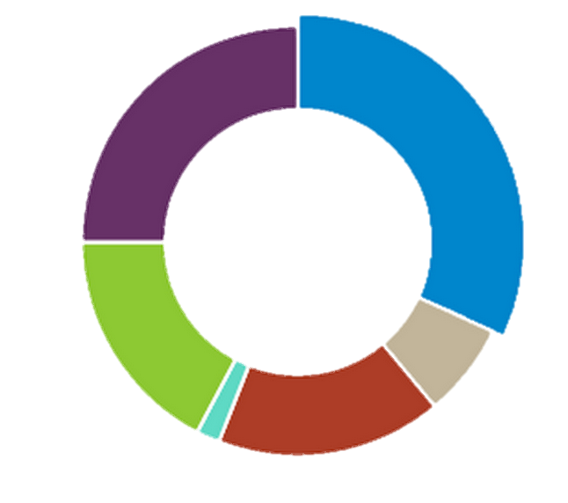
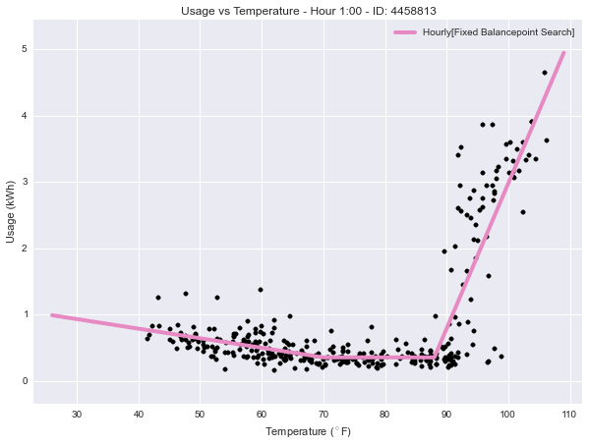
Energy Disaggregation and Setpoint Estimation
Cooling
32%

Slide 37
Energy Disaggregation
Cooling
Heating
Baseload
Notes:
All we typically get is how much energy the whole home used
We’d like to break this down into parts – how much was used for heating, cooling, etc.

Slide 38
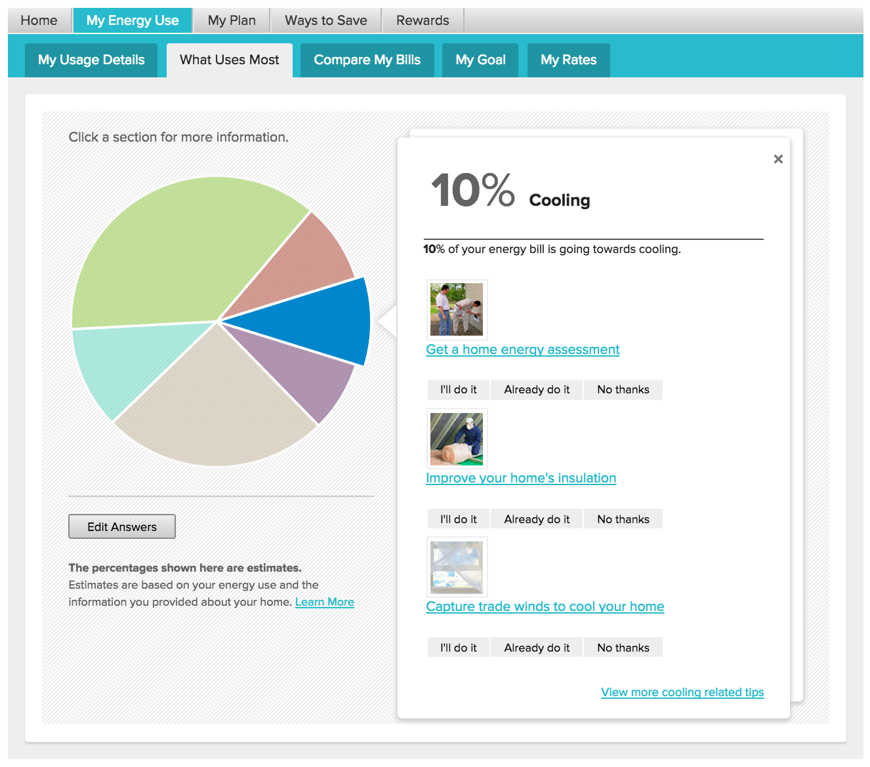
Disaggregation at Opower

Slide 39

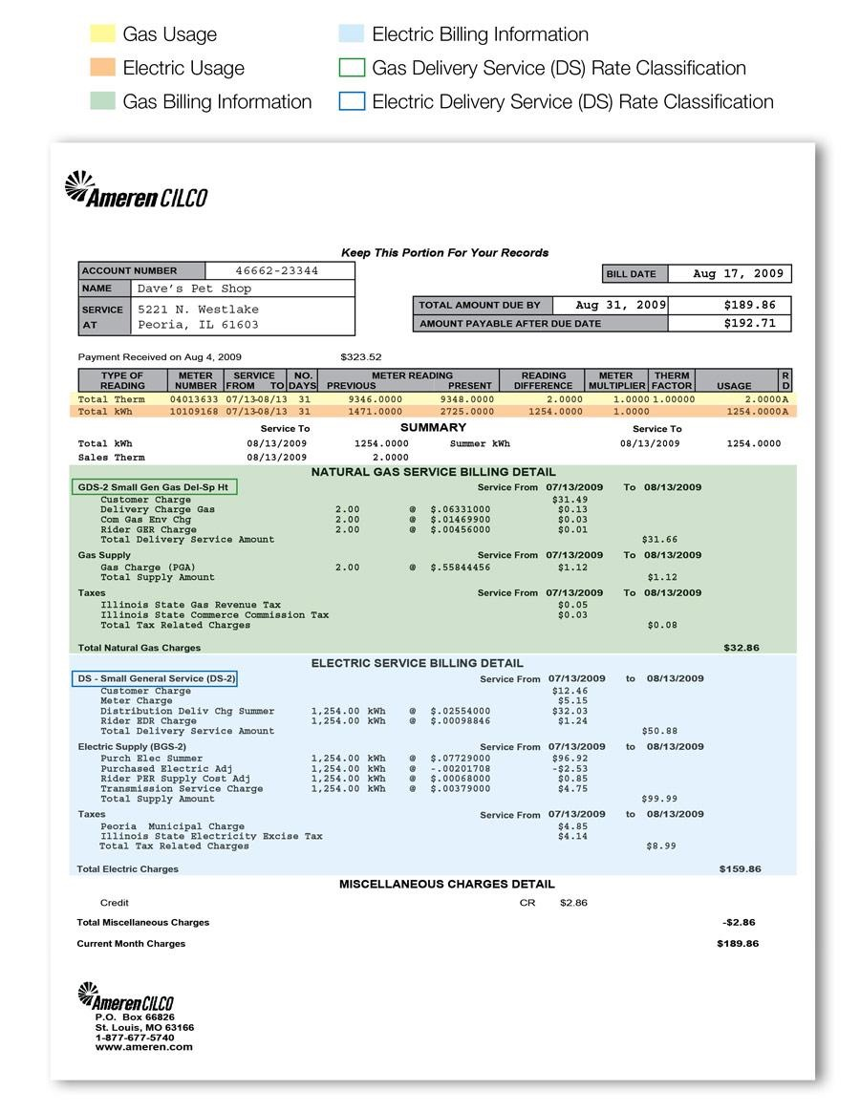

Beyond Heating/Cooling Disaggregation
Learn more about individual homes using just energy usage data (e.g., AMI, bills)

Slide 40
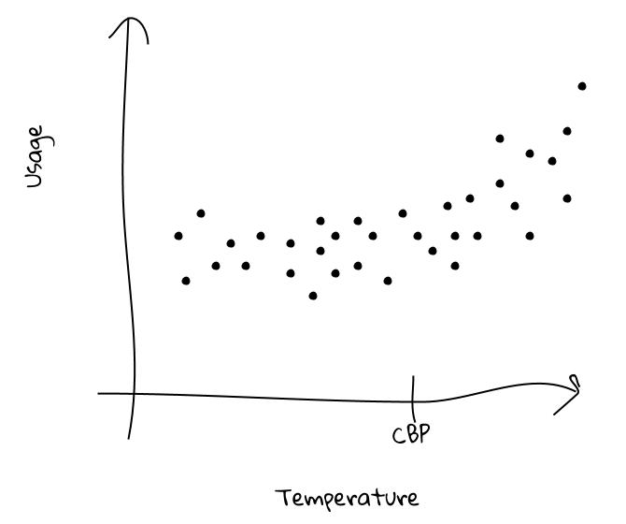
Setpoint Detection
one household
cooling load
base load
one hour
cooling setpoint
Notes:
One household in dark blue, baseload in dark blue, cooling load in same as cooling setpoint

Slide 41
Setpoint Detection
cooling setpoint - 88°

Slide 42
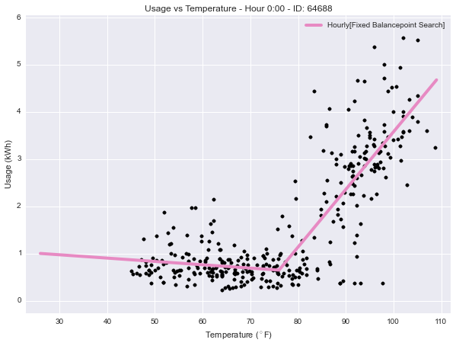
Setpoint Detection
cooling setpoint - 76°

Slide 43
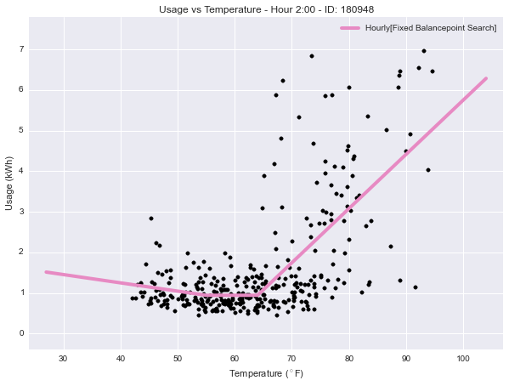
Setpoint Detection
cooling setpoint - 64°

Slide 44
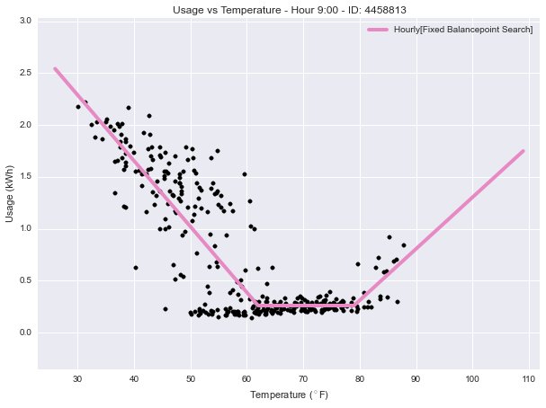
Setpoint Detection
cooling setpoint - 79°
heating setpoint - 62°

Slide 45
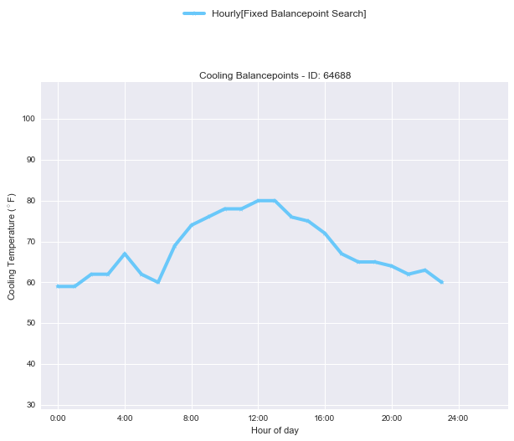
Setpoint Detection – Hourly Analysis

Slide 46
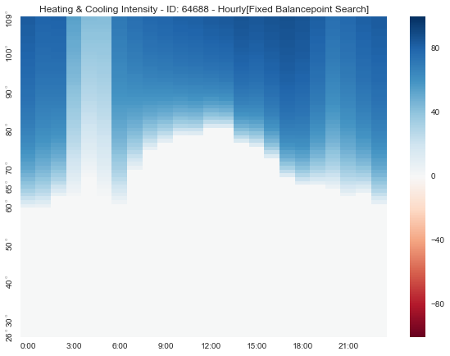
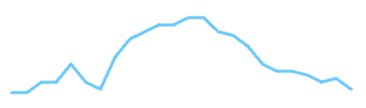
Setpoint Detection – Hourly Analysis
For any given temperature and hour of the day, what percentage of total usage is due to cooling?

Slide 47
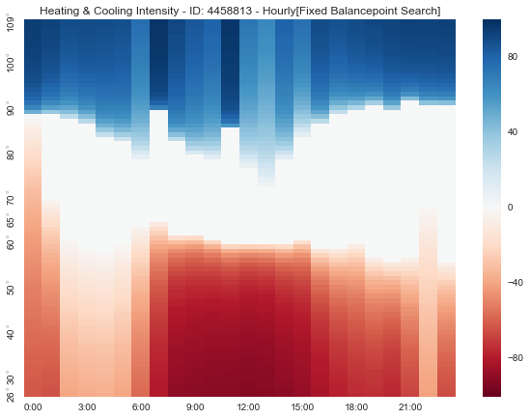
Setpoint Detection – hourly analysis

Slide 48
Accurate Disaggregation

Slide 49
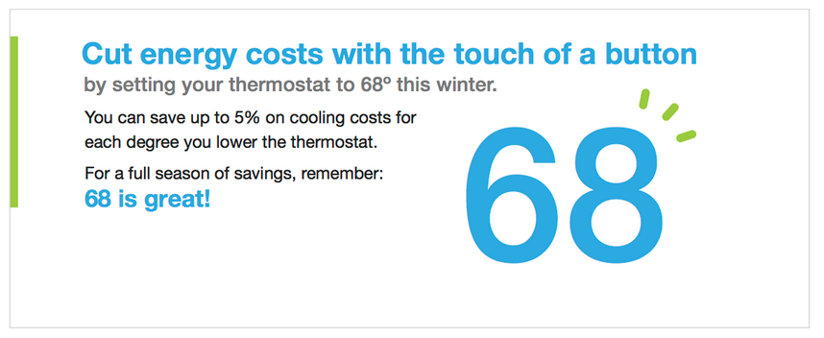
Tip Targeting
vision
Notes:
Split into 2

Slide 50
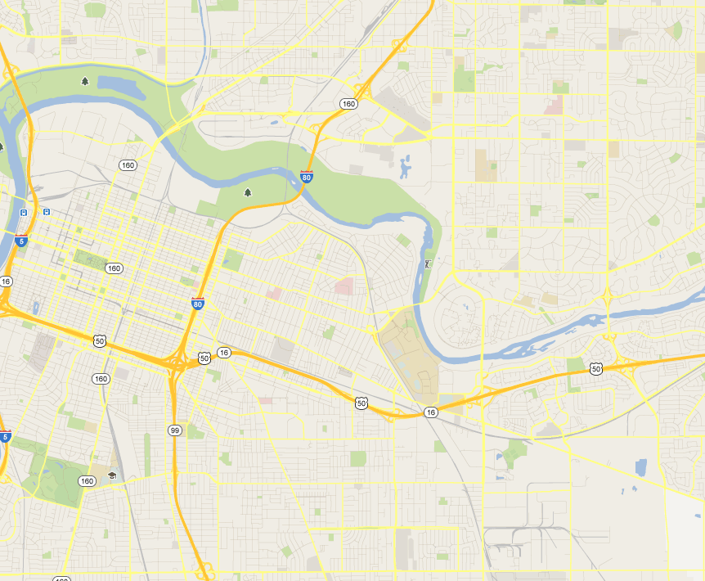

Household Targeting For DR Event
vision
vision
Setpoint: 74°
Event savings: 3 kWh
DR: MAYBE
Setpoint: 79°
Event savings: 0.5 kWh
DR: NO
Setpoint: 68°
Event savings: 5.5 kWh
DR: YES
Notes:
----- Meeting Notes (9/1/11 17:46) -----
White paper for why smart meters are good:
ID folks with AC, go crazy on those that aren't setting them

Slide 51
Bill Forecasting
vision
vision
Notes:
----- Meeting Notes (9/1/11 17:46) -----
White paper for why smart meters are good:
ID folks with AC, go crazy on those that aren't setting them

Slide 52
Thanks!

